Slide 1
114th street west center road – pacific street
Public information meeting
June 21, 2022

Slide 2
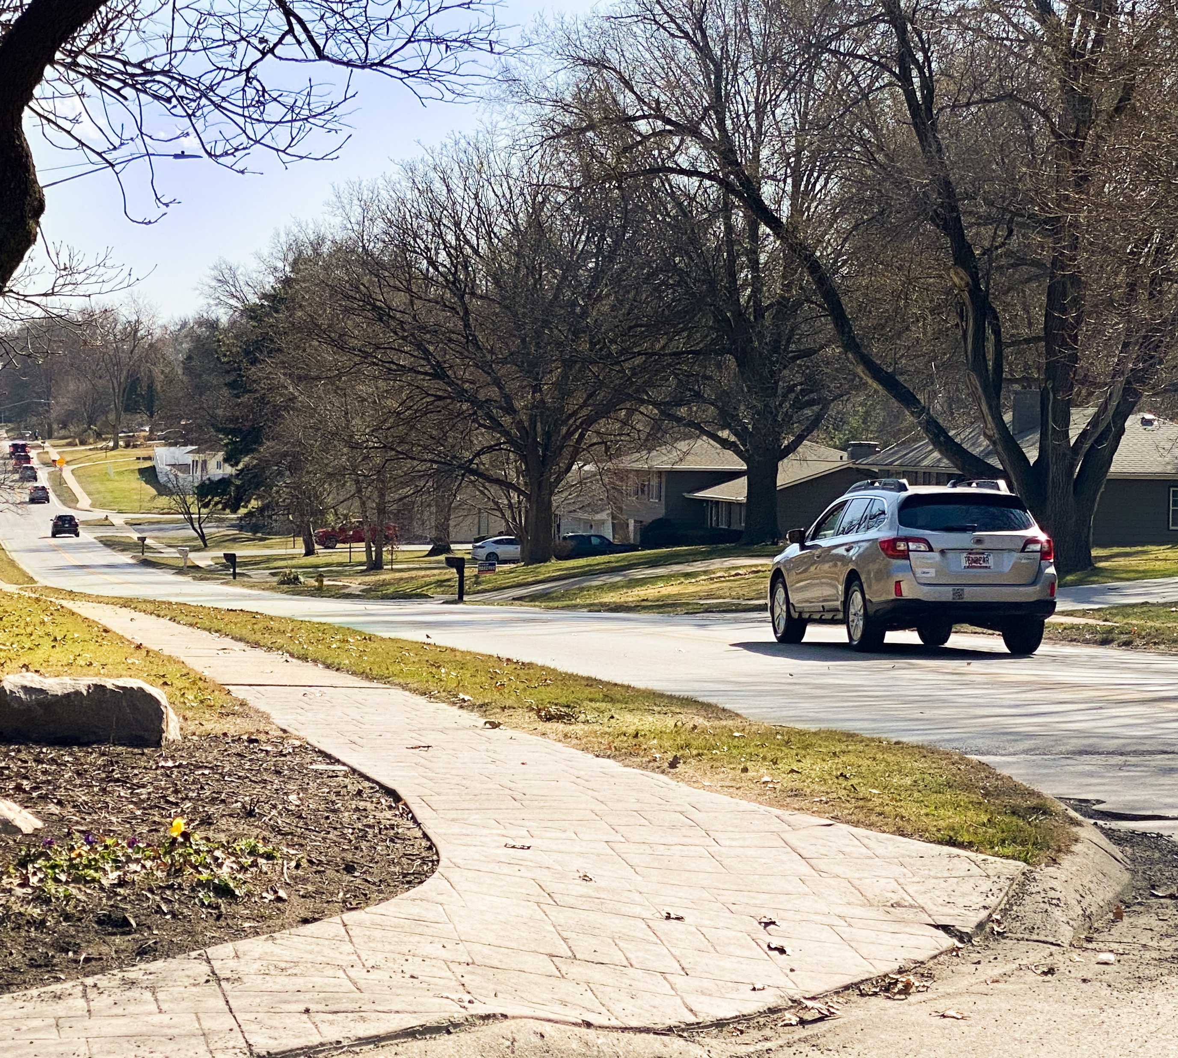
agenda
Presentation
Team Introductions
Project Overview
Proposed Improvements
Project Schedule
Stay Informed

Slide 3
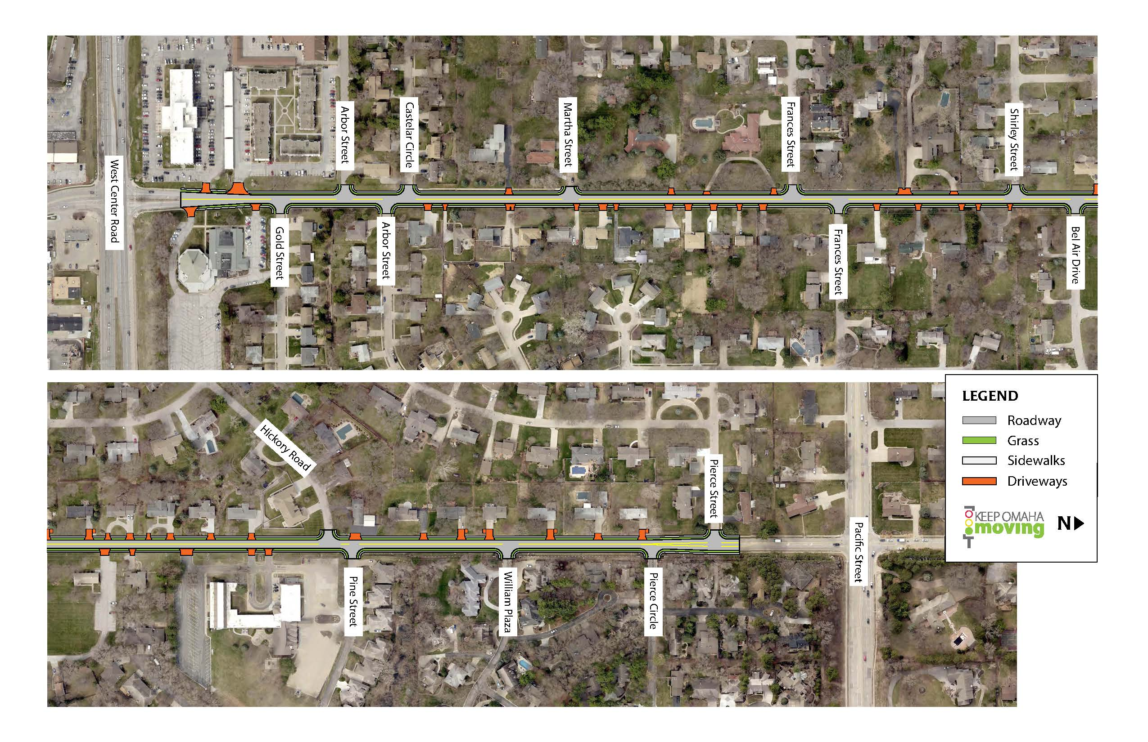
Project overview

Slide 4
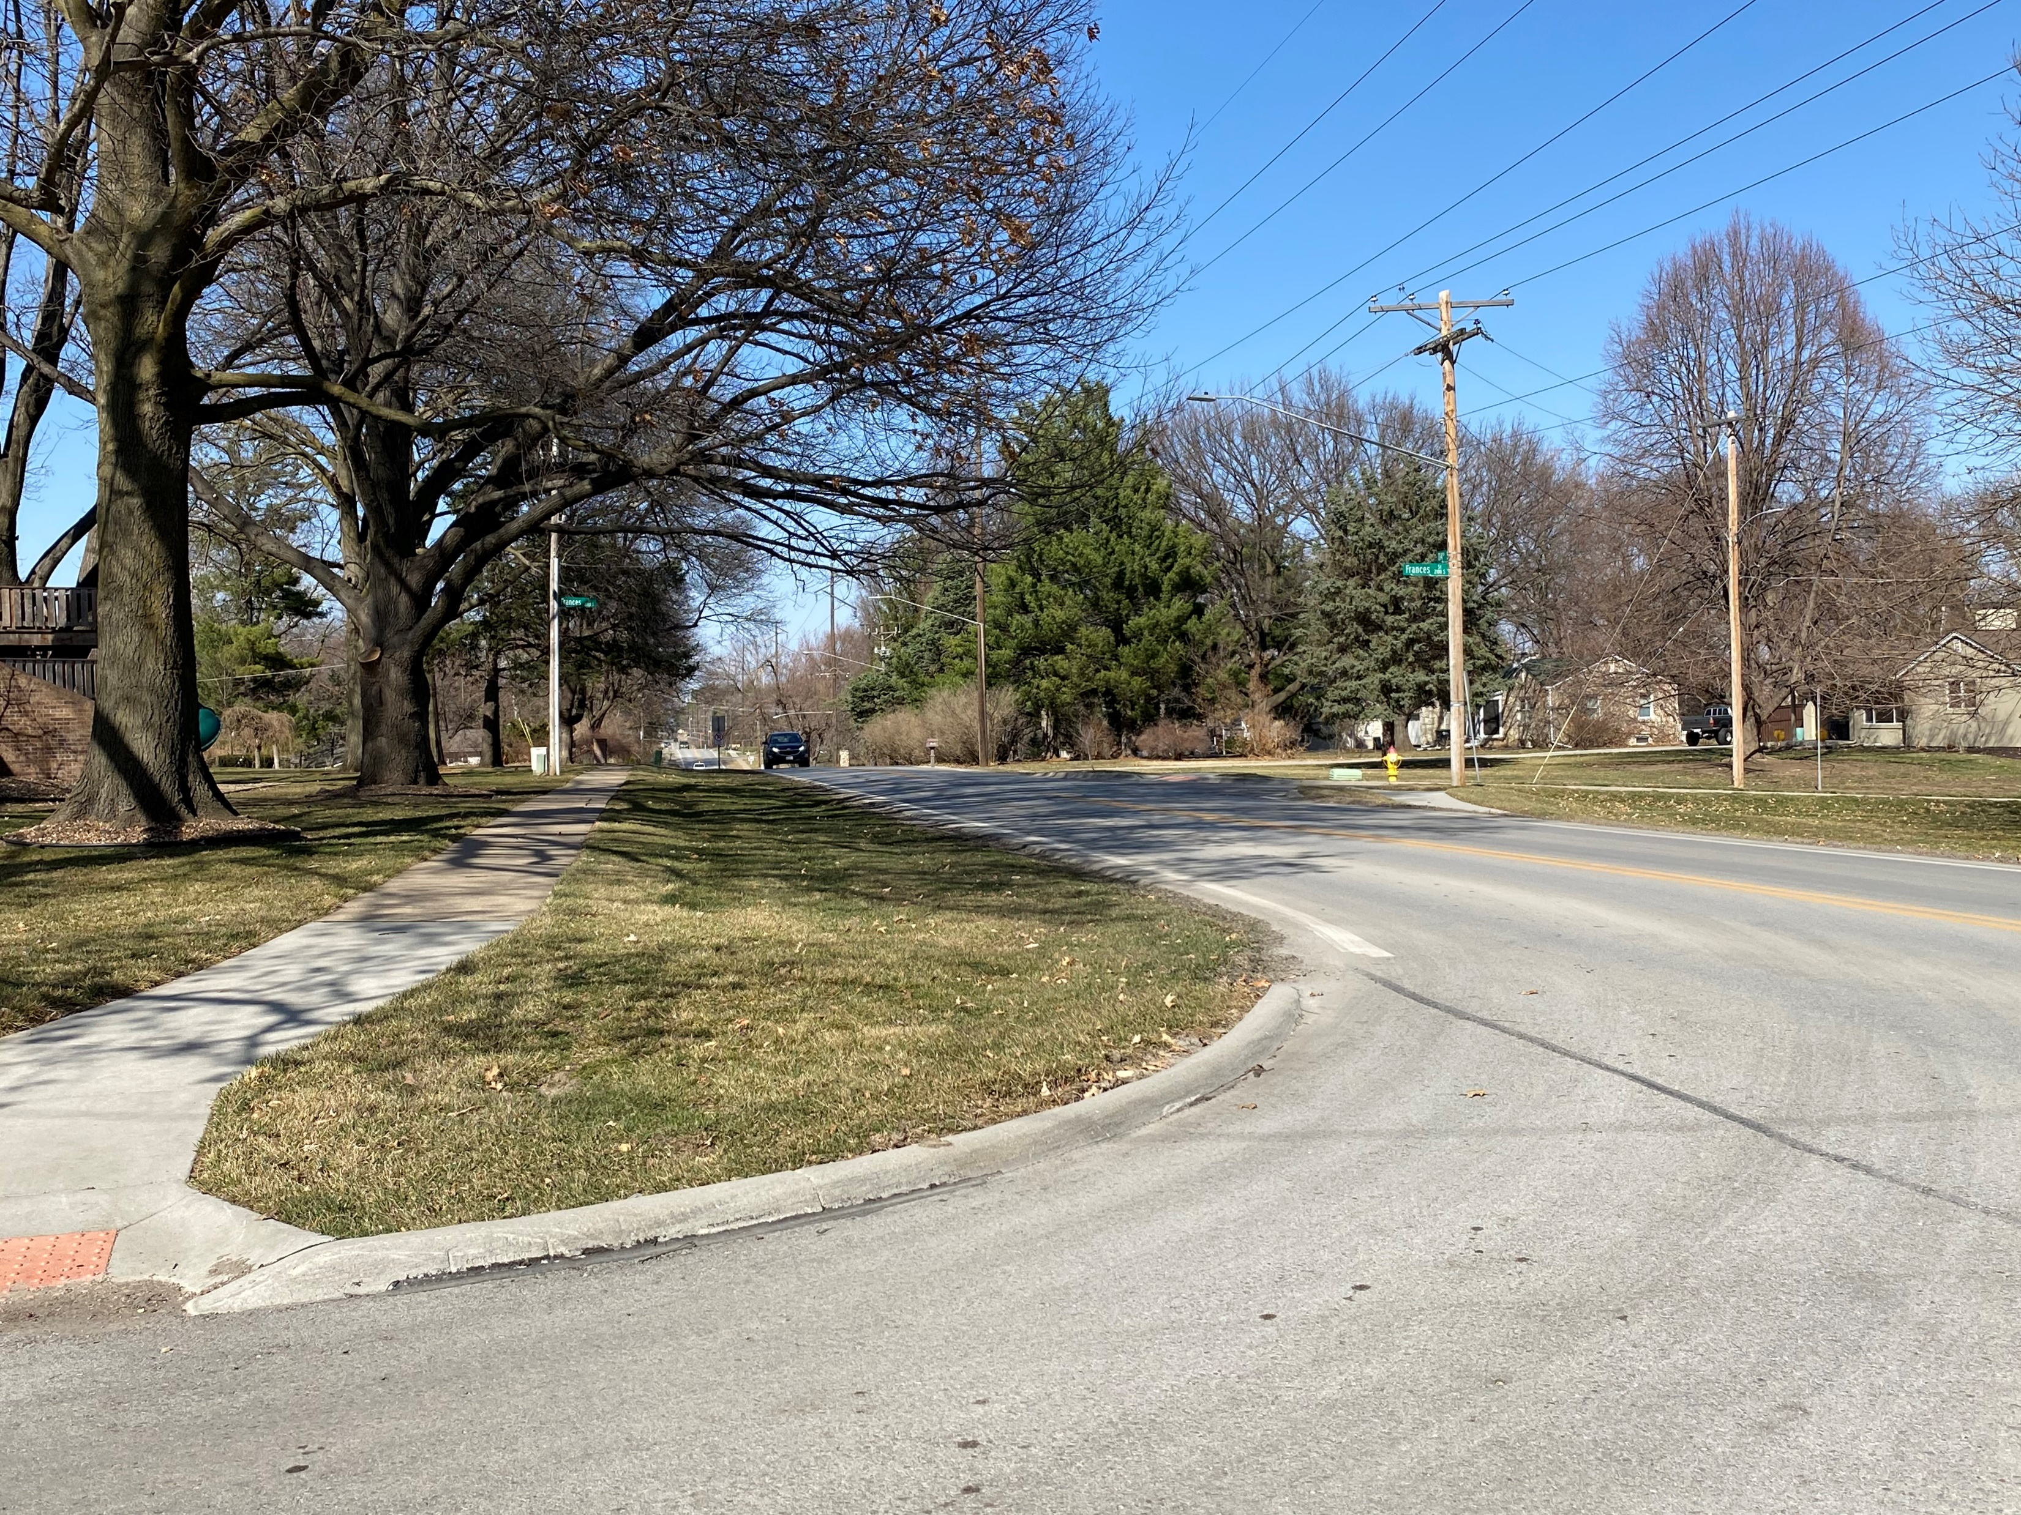
Project overview
Project Goals
Replace aging pavement
Improve drainage
Improve grades and intersection sight distances
Improve pedestrian and bicycle accommodations

Slide 5
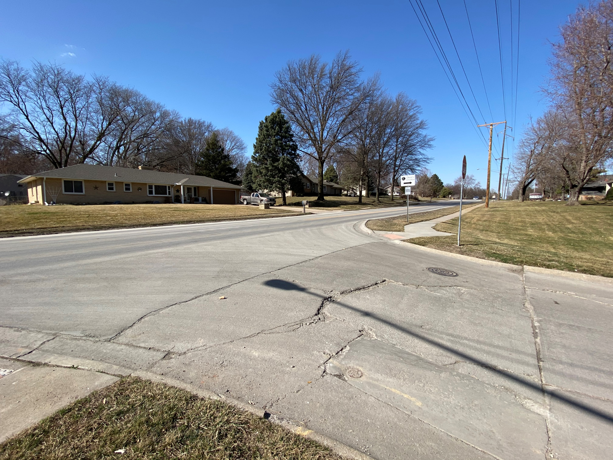
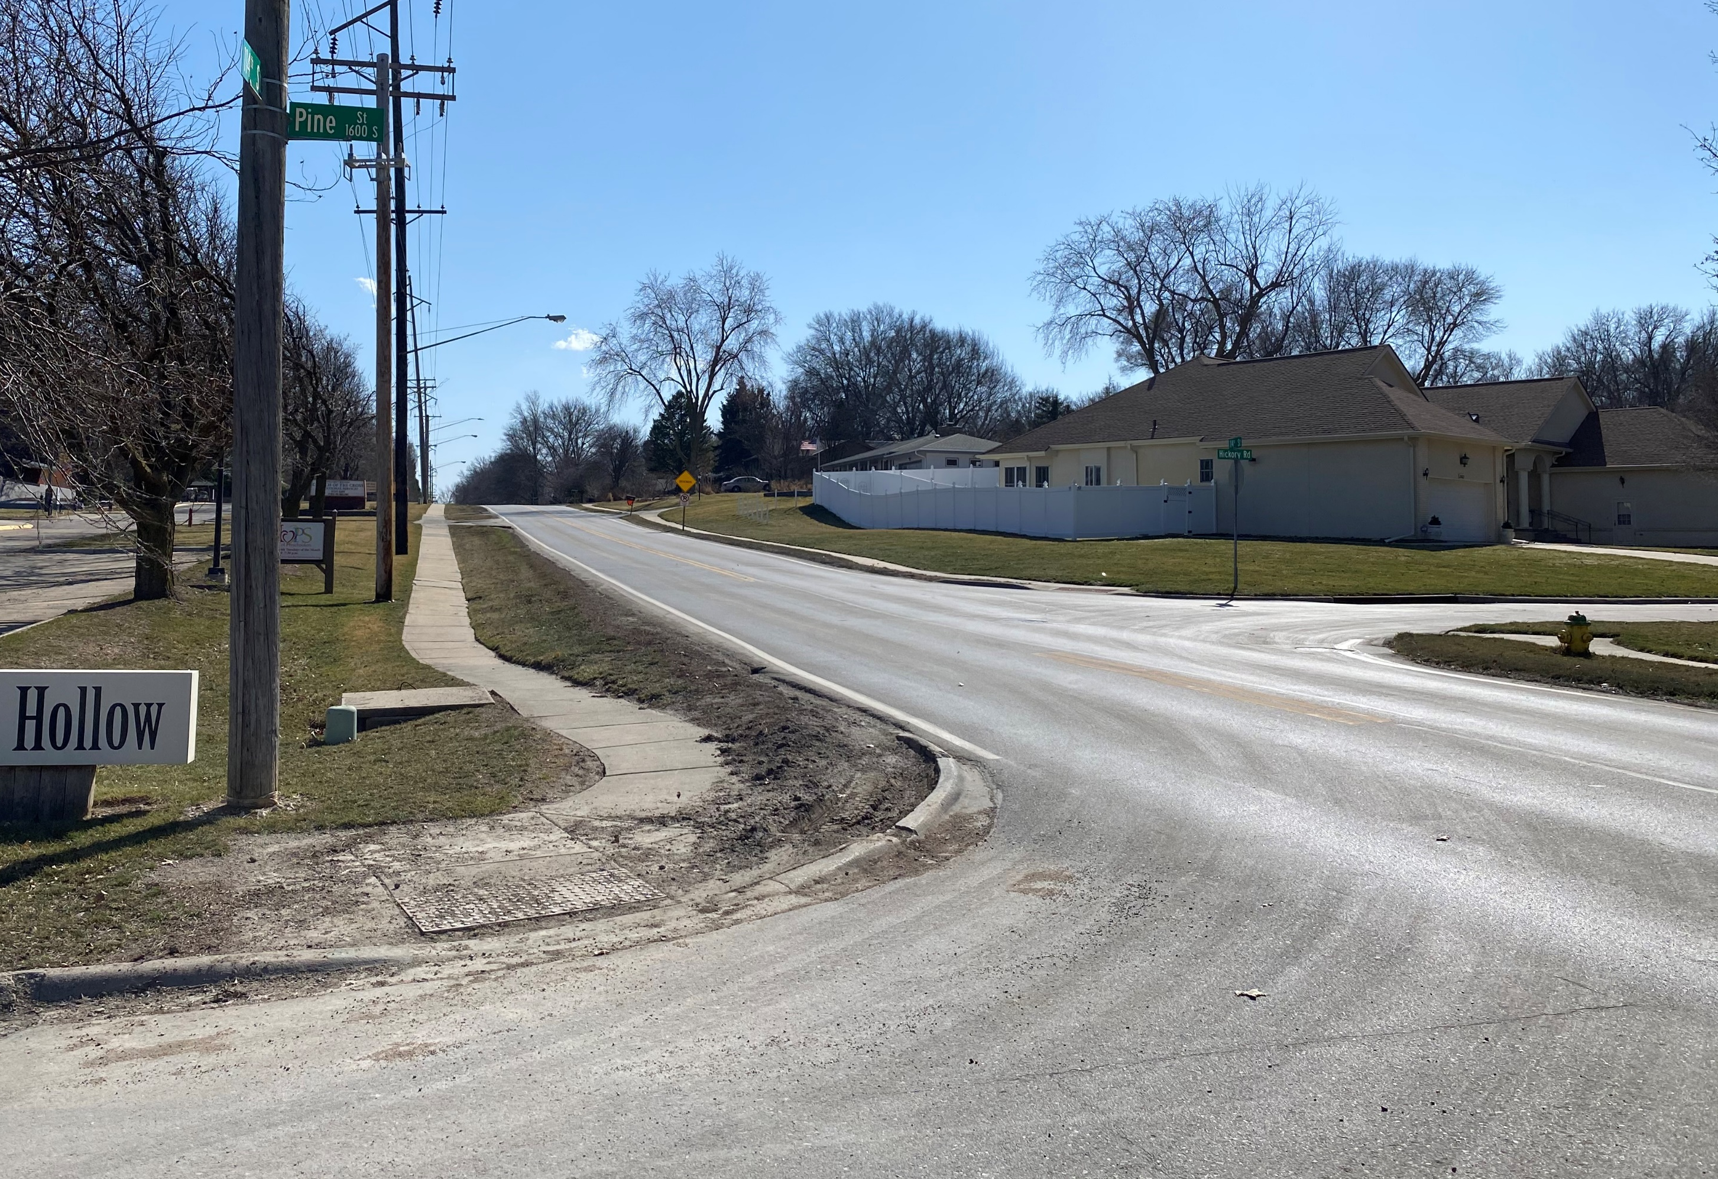
Proposed improvements
Construct new pavement
Replace sidewalks and curb ramps
Add curb and gutter
Add storm sewer

Slide 6
Project schedule

Slide 7
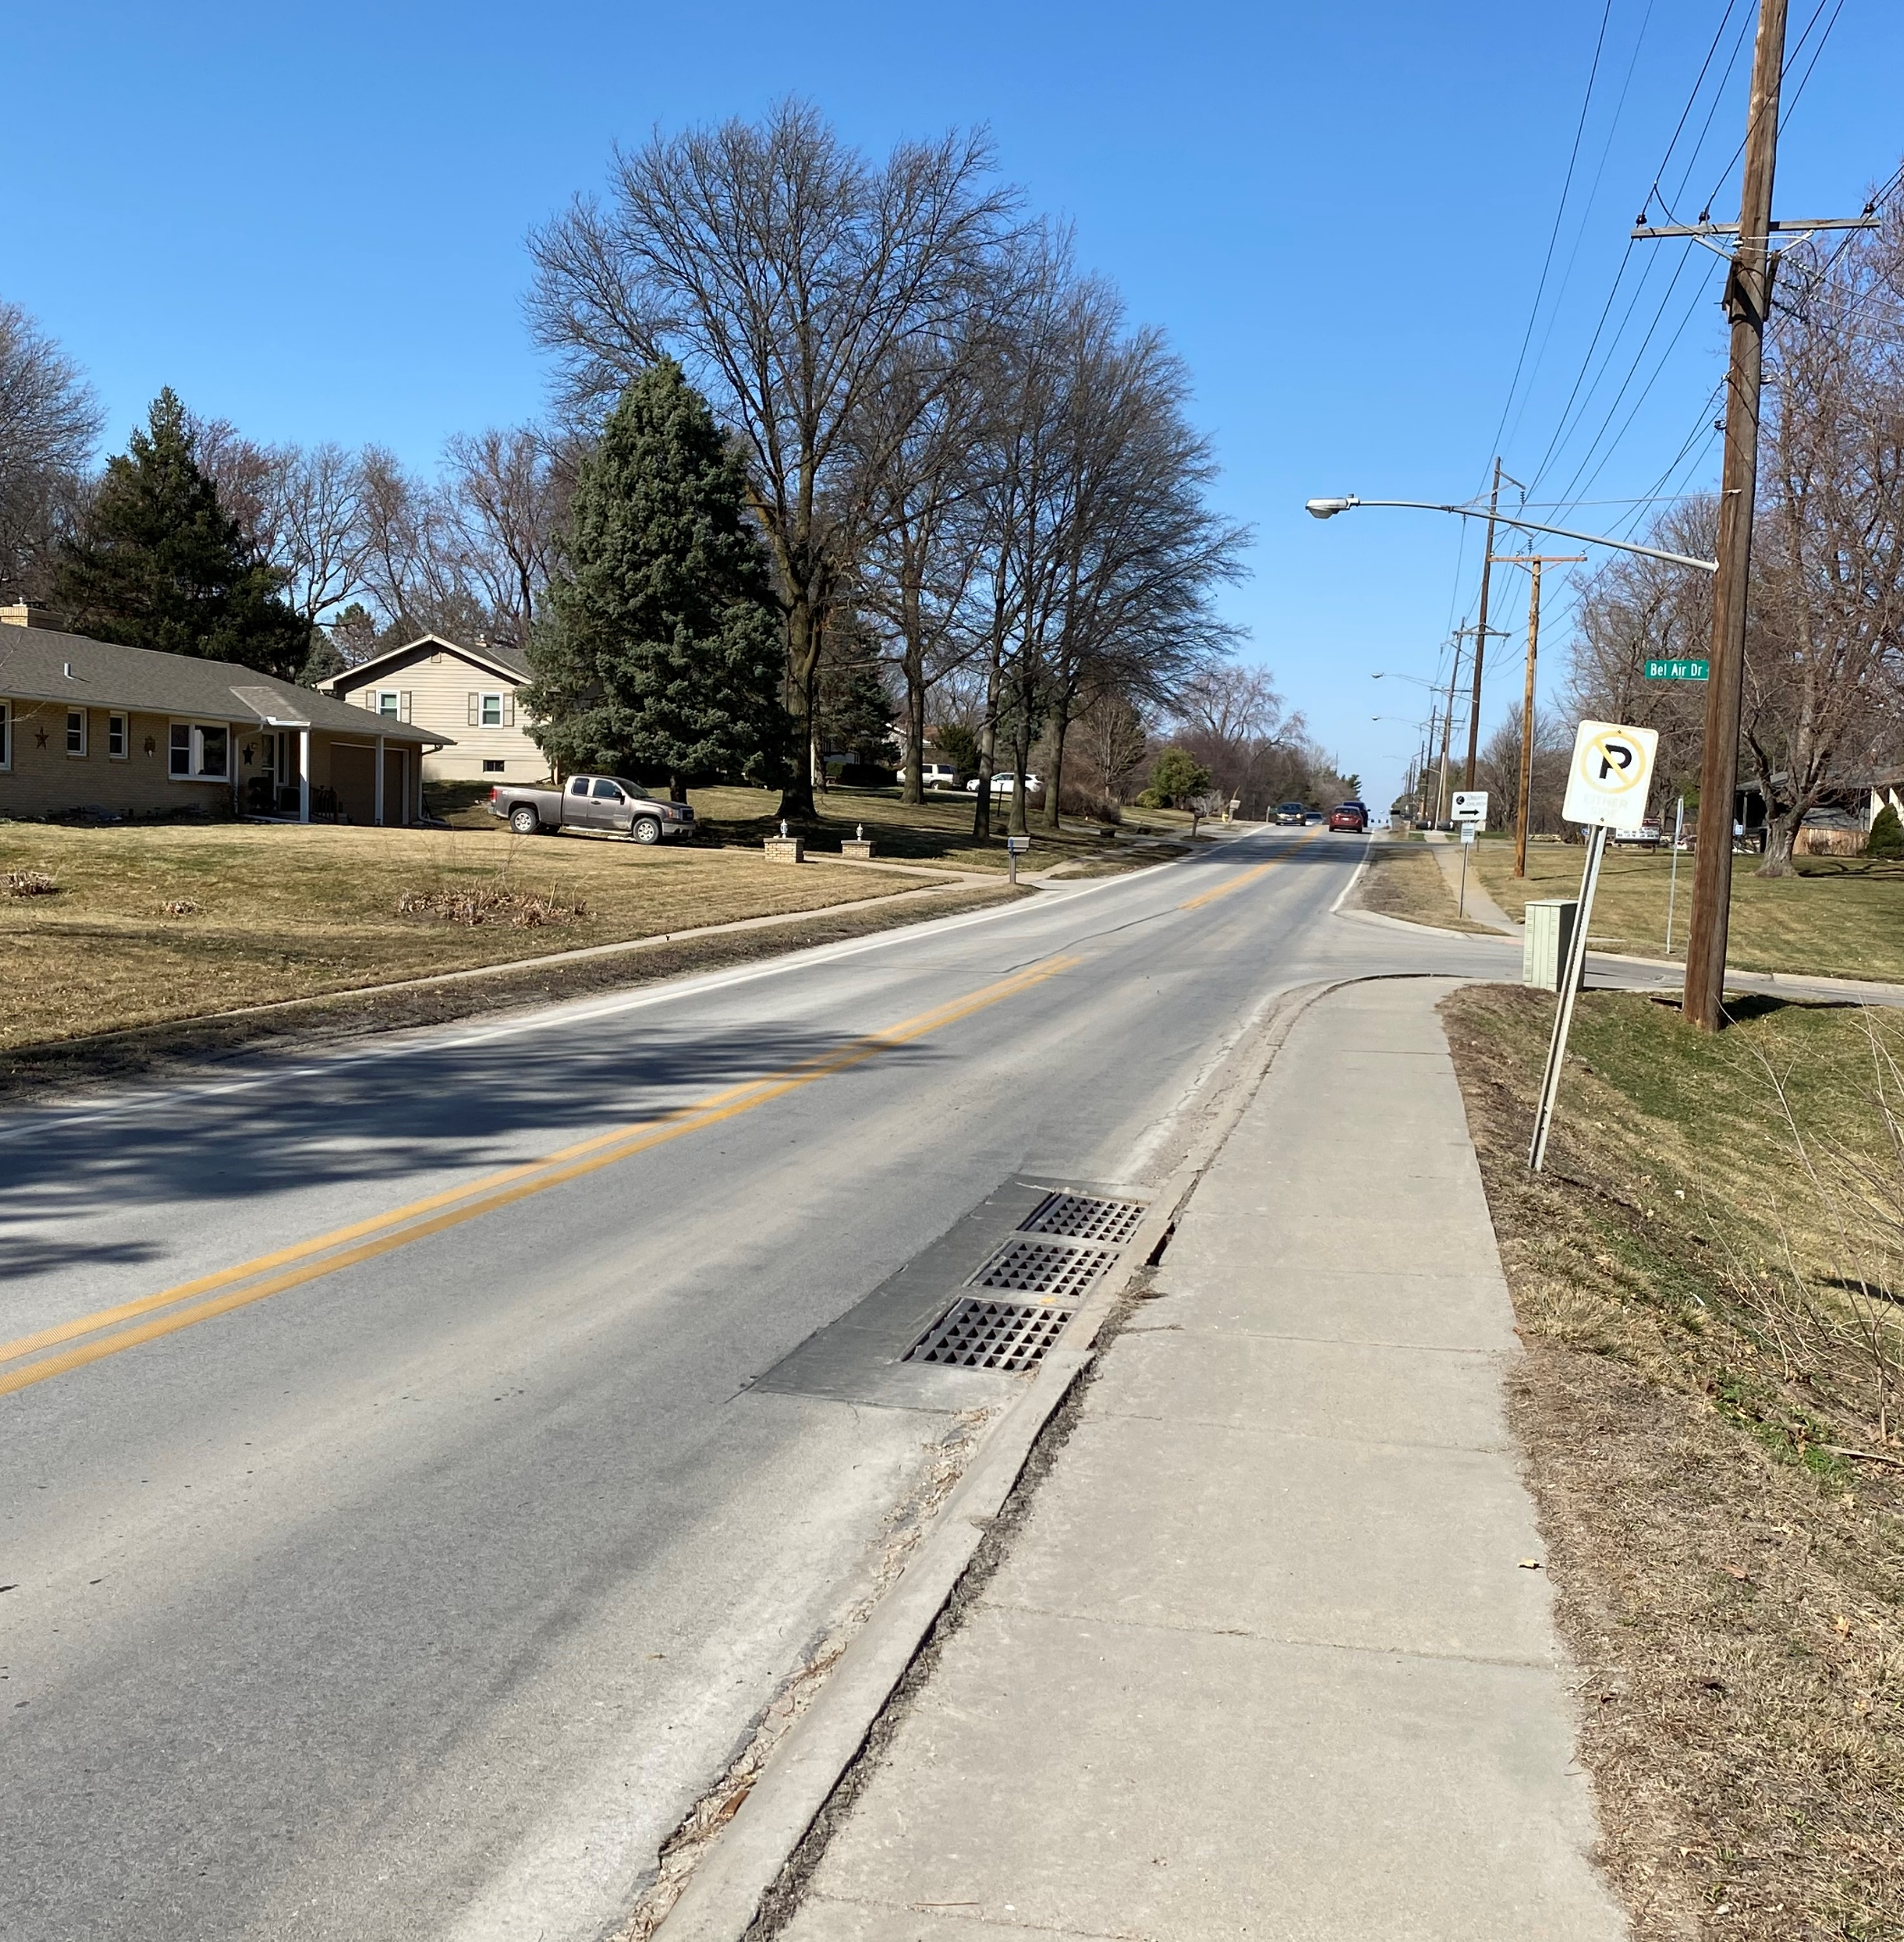
How to stay informed
Website
www.keepomahamoving.com
Project Contacts
Justin Zetterman, Project Manager
Public Works Design Division
justin.zetterman@cityofomaha.org
402-444-5220
Tony Egelhoff, PE
Olsson
tegelhoff@olsson.com
402-341-1116

